Slide 2
Project 1 Question 2:
Develop an app that can easily tell a combination of handwritten number images.
- Number combination will be randomly selected from test data used for training and testing the knn model.

Slide 3
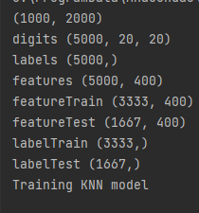

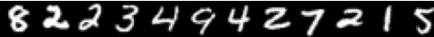
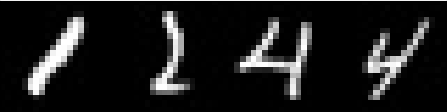


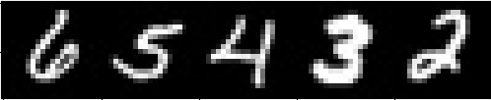
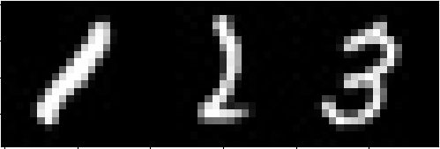
Input and Output

Slide 4
Project 1 Question 3
Develop an app that can recognize faces in an image and a video

Slide 5
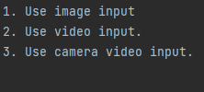
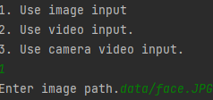
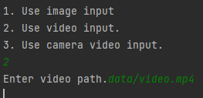
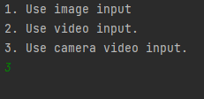
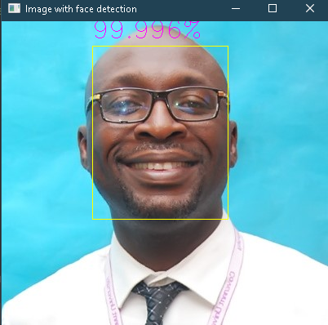
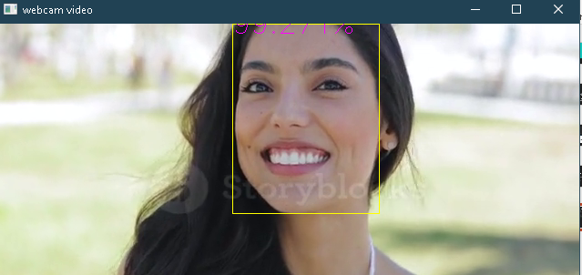
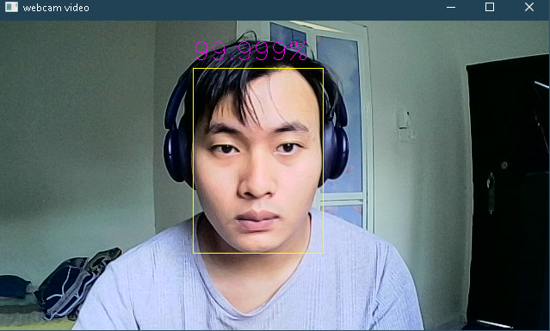
Input and Output

Slide 6
1. knn_model()
Train knn model for handwritten number and return the trained knn model.
create_data()
- Create a numpy array from digits.png, in a way that all the numbers are lined up in one line. The numpy array are returned as list_of_num
3. generate_num_img(list_of_num, number=1234, use_random=False, random_len=4):
Generate image of number based on number passed or generate image of a random number with number of digits as much as random_len.
4. test_handwriting(filename, knn, numbers_list)
Take image generated by generate_num_img function, knn model trained by knn_model function,
list_num generated by create_data function and number inputted(number) by user .
5. sequence()
- Ask user to input sequence of number separated by space and pass each number to test_handwriting function.

Slide 7
1. detectFace(path)
- Take location of image(path) and apply face detection on it by using a pretrained tensorflow model.
3. camera()
-Get frame from camera and pass frame to detectFace(path) . The inferenced frame and displayed an opencv window. .
4. video(path)
-Take location of video and pass the video’s frame to detectFace(path) . The inferenced frame are displayed in an OpenCV window.
5. image(path)
- Take location of video and pass the video’s frame to detectFace(path) . The inferenced frame are displayed in an OpenCV window.

